Slide 1
Polymer Education for Students and Public
Choon H. Do
Dept of Fisheries System Eng., National Fisheries R & D Institute,
Busan , KOREA
E-mail: choondo@sunchon.ac.kr
(Dept. of Polymer Sci. & Eng., Sunchon National Univ.,
NR and TM (2000-2013) of Committee on Chemical Education, IUPAC)

Slide 2
‘Polymer’ Education
Polymer Science and Technologies
become popular due to the advent of
Nano Sciences and Technology
(size: 1-100 nm)
polymeric materials – nano(size) materials

Slide 3
Polymer Education at
* Universities and Colleges
* Scientific Societies
* Cyber Education
* Short Courses

Slide 4
Polymer Education at Universities and Colleges
Departments – Polymer Sci. & Eng.,
Chemical Engineering,
Chemistry,
Materials Sci.,
Nano Science,
Biomaterials &
Medicinal materials

Slide 5
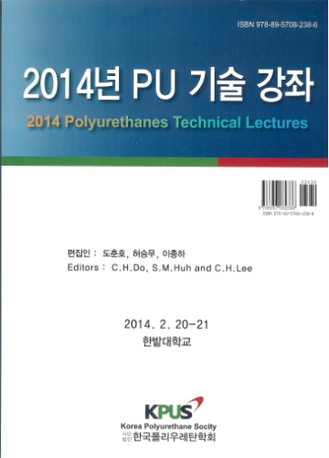
Polymer Education in Scientific Societies
* The Polymer Society of Korea (www.polymer.or.kr)
- Polymer Academy,
- Polymer Forum,
- Polymer New Technology Lecture,
- Academy-Industry-Research Workshop
* Korea Polyurethane Society (www.kpus.or.kr)
– PU Technical Lectures
* Korean Society for Biomaterials (www.ksbm.or.kr)
- workshops
* Other Societies - workshops

Slide 6
Cyber Lectures for Polymer Education: http://www.chemistryculture.org/ChemStory/cypolychemtech.html

Slide 8
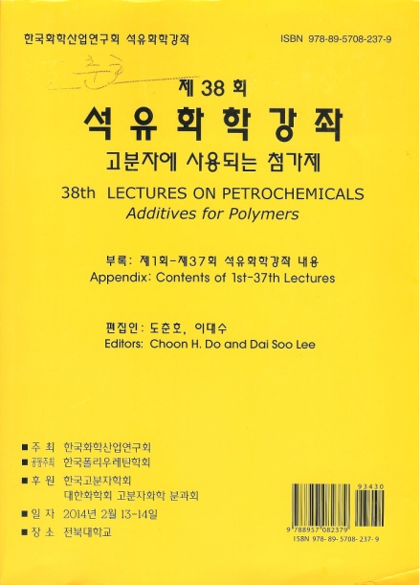
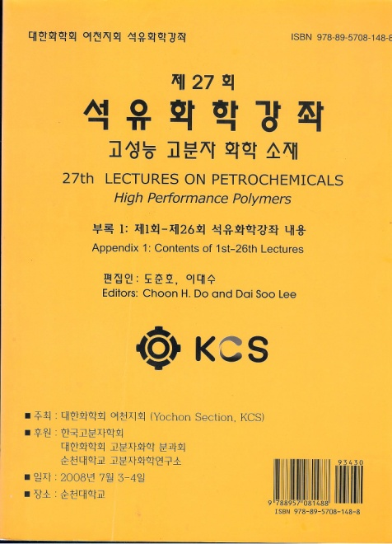
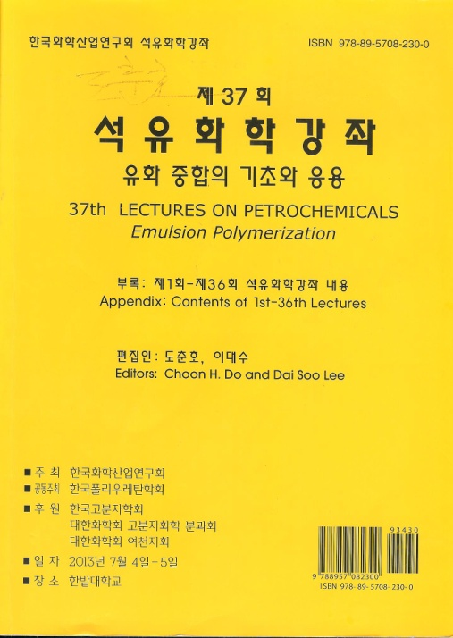
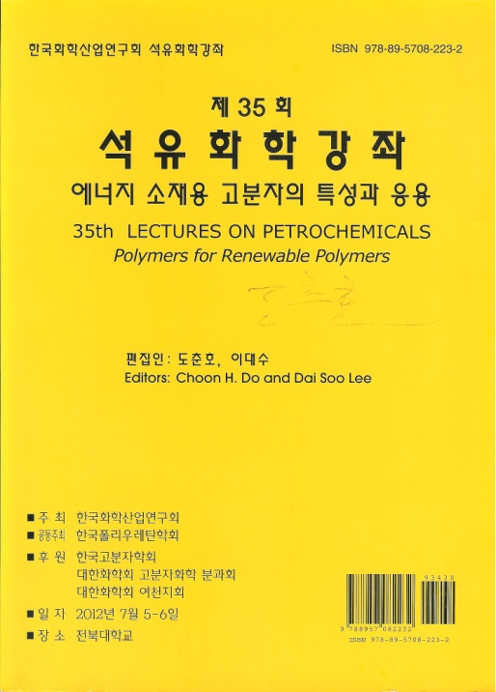
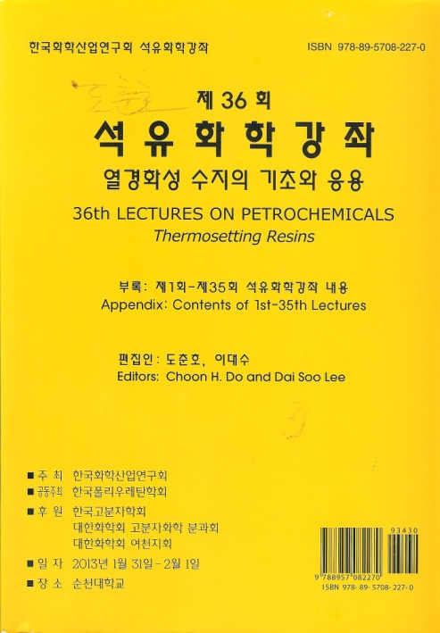
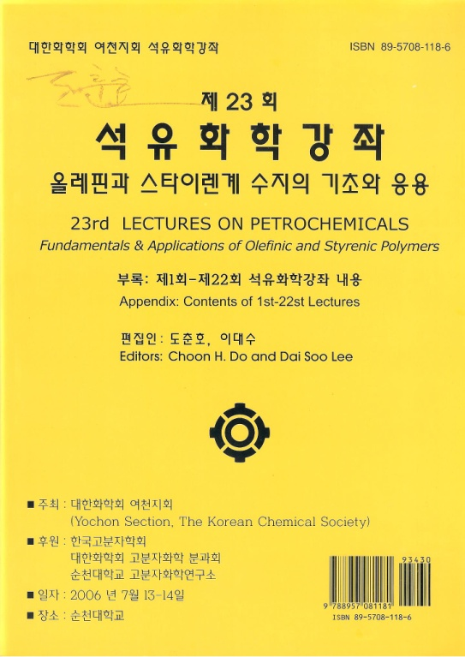
Lectures on Petrochemicals, June 1995-Present
high performance
additives
For energy
emulsion
polym.
thermosets
Olefins & styrenics

Slide 9
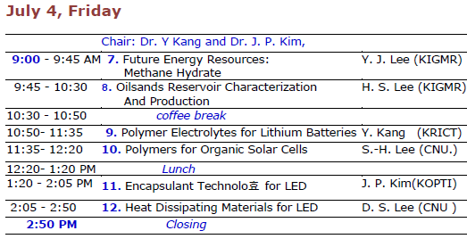

Slide 10
Web site of Lectures on Petrochemicals: www.kcirg.org

Slide 11
Conclusions
To promote and improve ‘Polymer Education’,
Provide more
(1) information,
(2) materials &
(3) opportunity to learners

Slide 12
Thank you
for your attention

